Slide 1
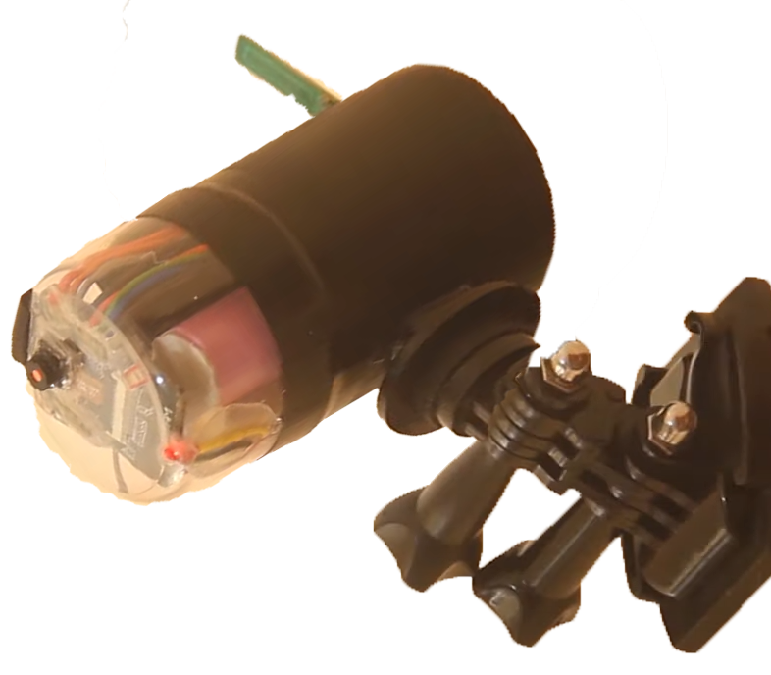


Smart Entry System (Smart Surveillance System)

Slide 2
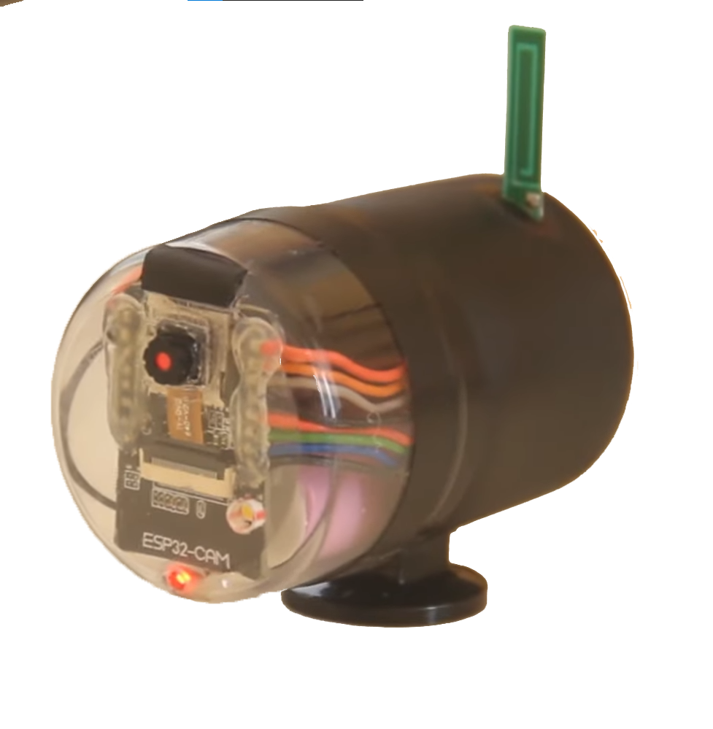
Agenda Style
01
INTRODUCTION
02
PROBLEM SET
03
OUR SOLUTION
04
PROJECT INFOGRAPHIC
05
HARDWARE & IOT
06
AI
07
Website & Mobile App.
08
FUTURE WORK

Slide 3
INTRODUCTION

Slide 4
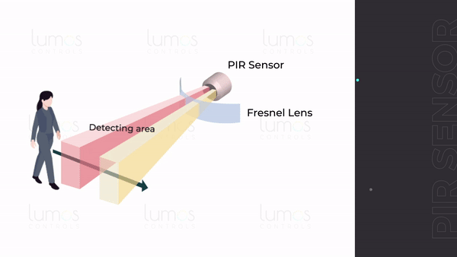
Introduction
It's Impractical To Use Large Number Of Sensors To Make A Smart Device.
Traditional Smart Home Have Enormous Sensors For Every Task.
Pir, Humidity, ...
How We Can Replace A Lot Of These Sensors With Just One Device To Perform All These Tasks.

Slide 5
Problem Set

Slide 6
Problem Set
01
High cost for electronic components
02
Consumption intensive electricity in security System devices
03
Accidents of theft of houses and many others

Slide 7
OUR SOLUTION

Slide 8
OUR SOLUTION
We build a full security system with camera that can perform these tasks. We now can get:
Night and light detection
Face detection
Face recognition
Motion detection
Object detection (persons, cars, …)

Slide 9
WORK OVERVIEW

Slide 10
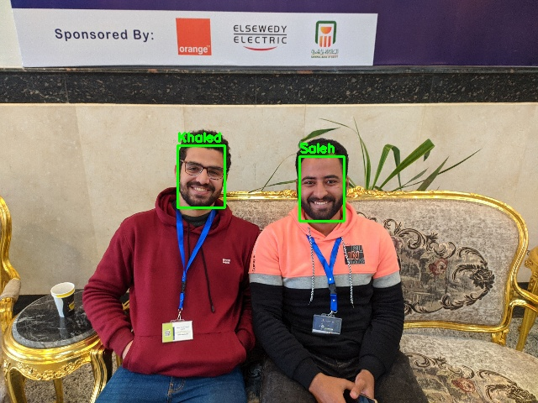
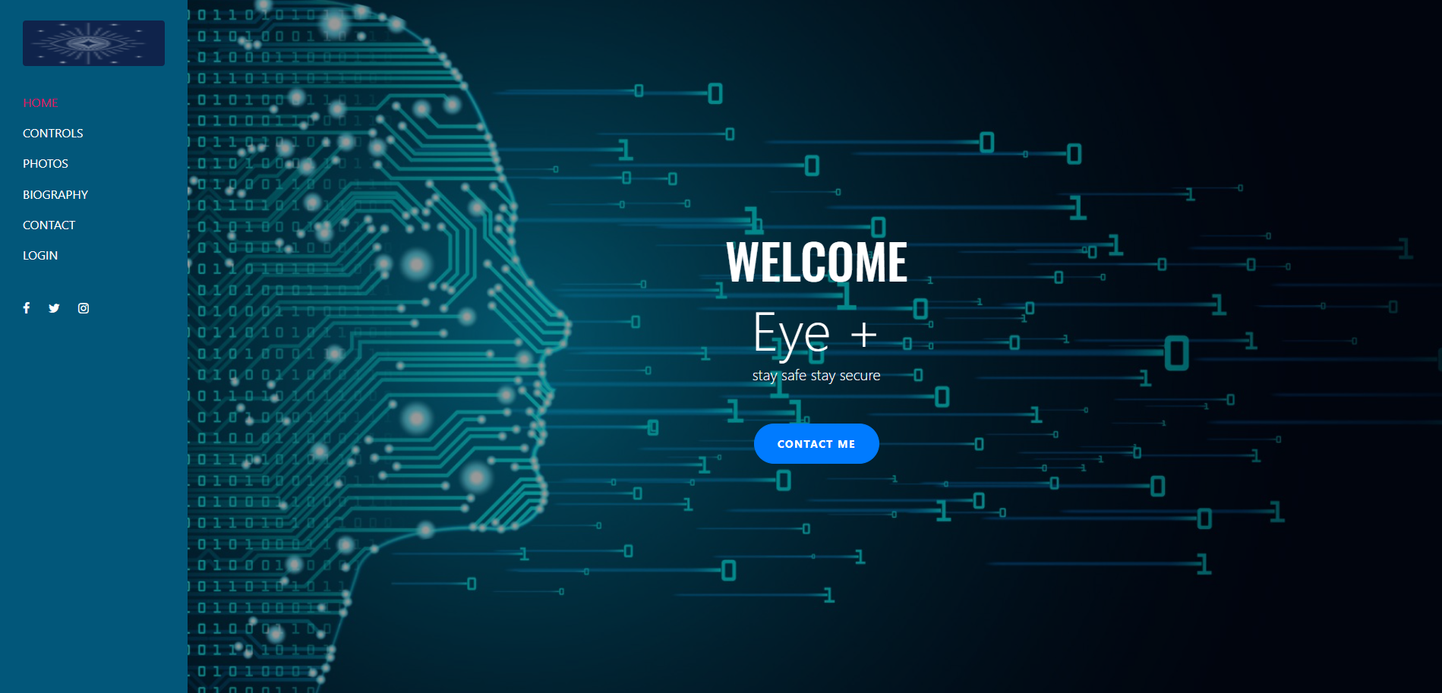

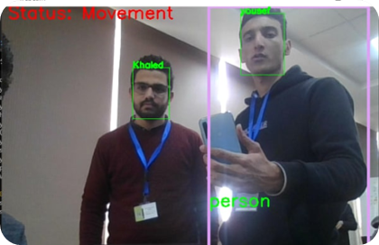
WORK OVERVIEW
Deep learning
Web application
Face Recognition
Display data
Deep learning
Face Detection
Deep learning
Object Detection
IoT
Day & Night
Send & Receive data

Slide 11


WORK OVERVIEW
Motion Detection
The video is series of the images. (Fps)
How the motion detection work?!
By doing subtract ion between the previews image and the current one, we simply detect
Face Detection & Recognition
Face Detection & Recognition
Real-time face detection , recognition we used:
We trained state of the art model to detect
The faces of the family members and as a method of authentications while
Notifying the presence of detected strangers.
Night & Light
We assign a threshold to determine if it's day or night. If the average of the brightness of the image greater than the threshold, it will be a daytime image and vice versa.
Motion Detection & Tracking
Night & Light

Slide 12



PROJECT INFOGRAPHIC
Mobile Application
WAN
Python and Django
AI
Python Script
WIFI
WIFI
ESP12e
RFID
Database
ESP32 CAM
Unlock door

Slide 13
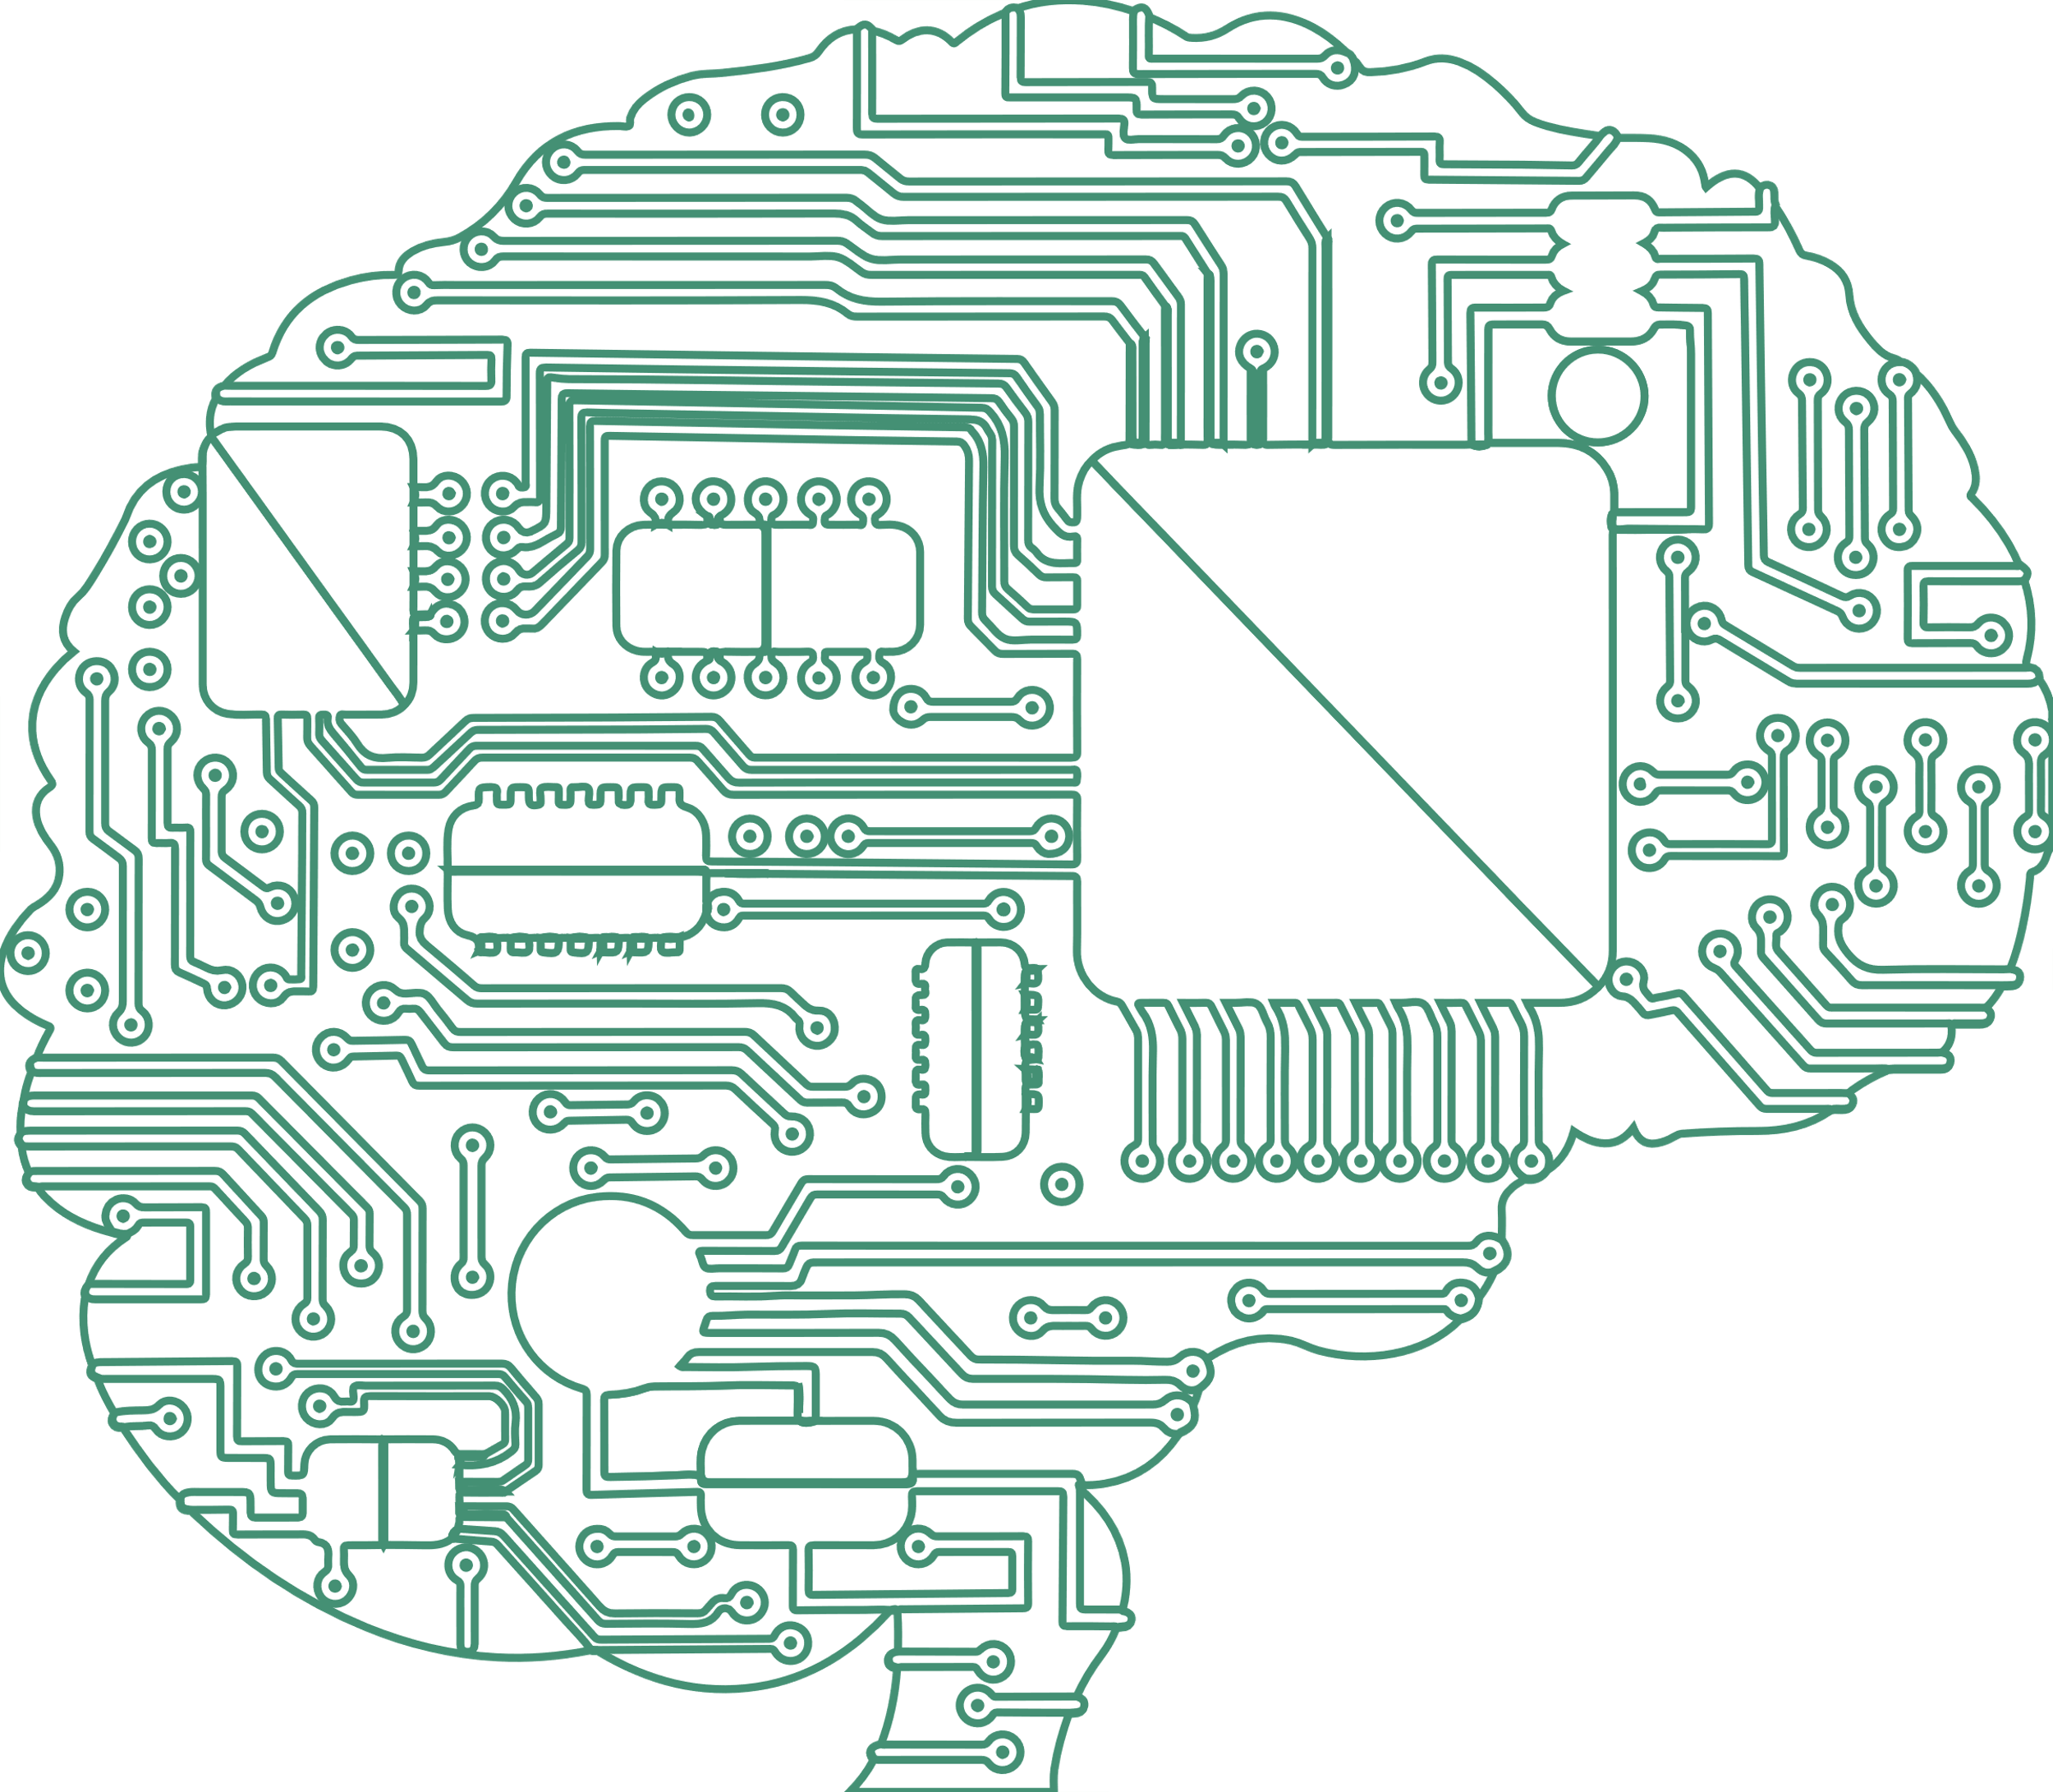
HARDWARE & IOT

Slide 14
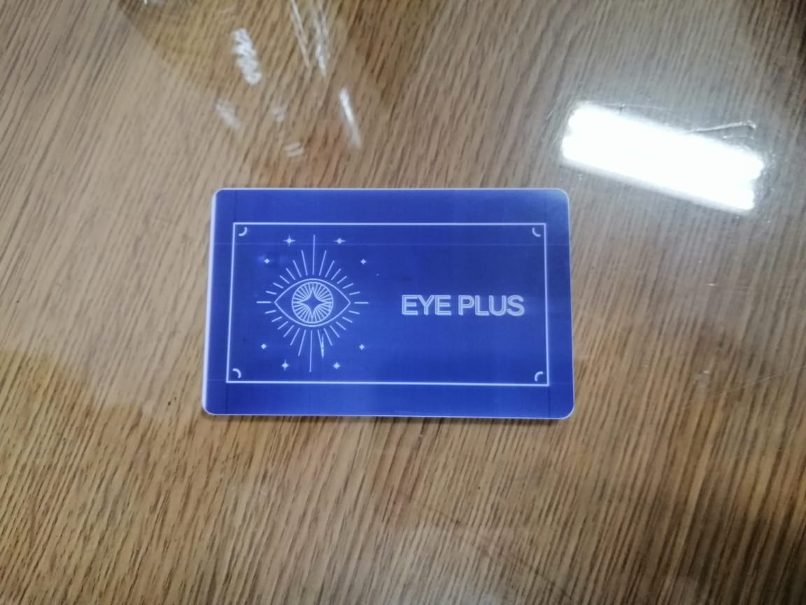
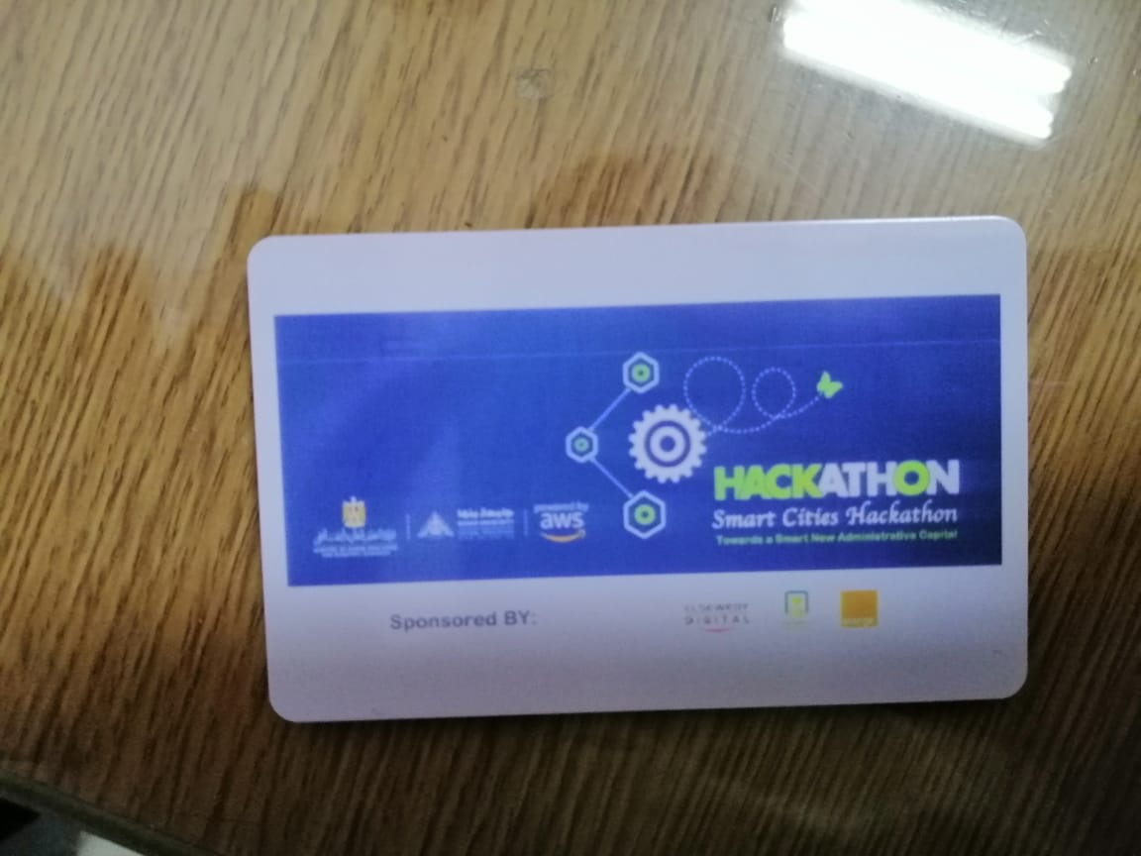
HARDWARE & IOT
To complete the eco system we used:
RFID door lock enabled to control the opening and closing of the doors with additional access to it anywhere and any time
Online access to the door lock anywhere at any time and schedule door opening for events like family visits and invitations.

Slide 15
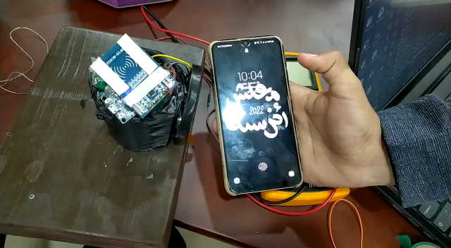
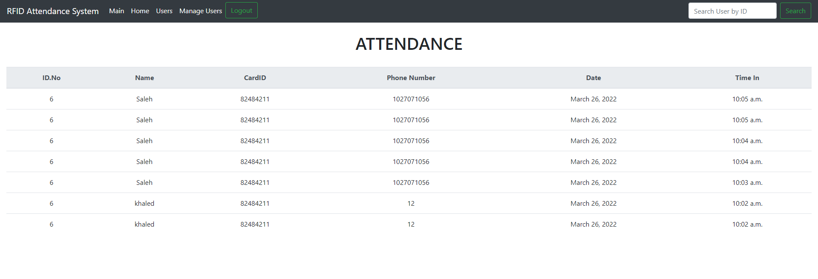
HARDWARE & IOT
Attendance system
We built an attendance system to tracking any one in the facilities and know the entry time.
Making it impossible for unauthorized person to enter without alerting the owner.

Slide 16
AI & Deep Learning

Slide 17




Deep Learning
DNN

Slide 18


Financials

Slide 19
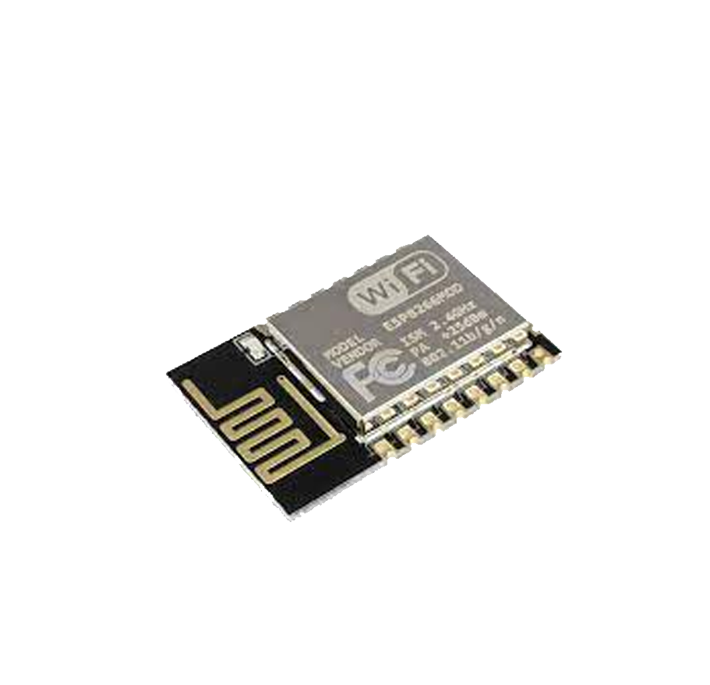
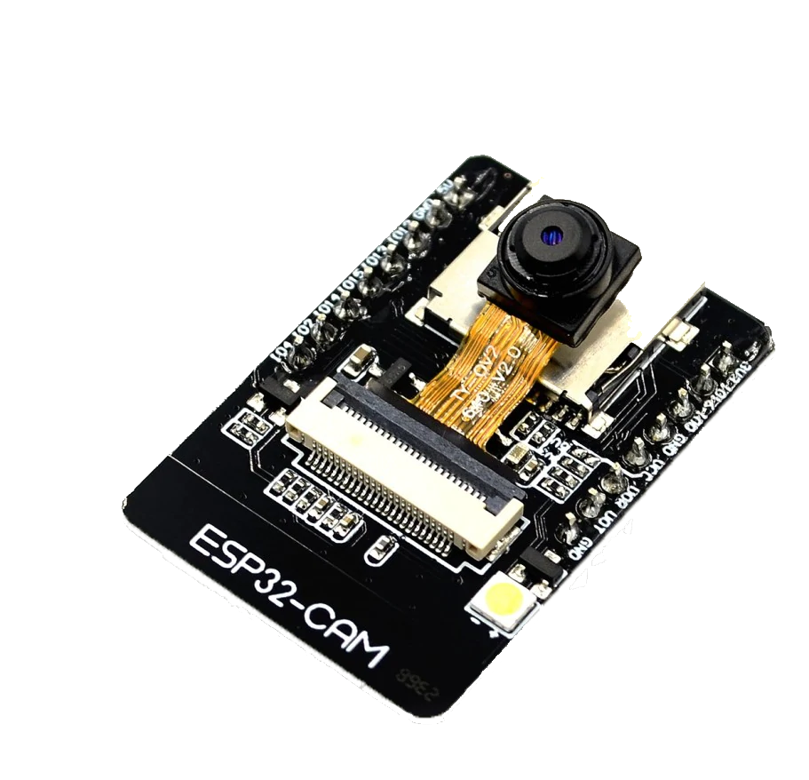
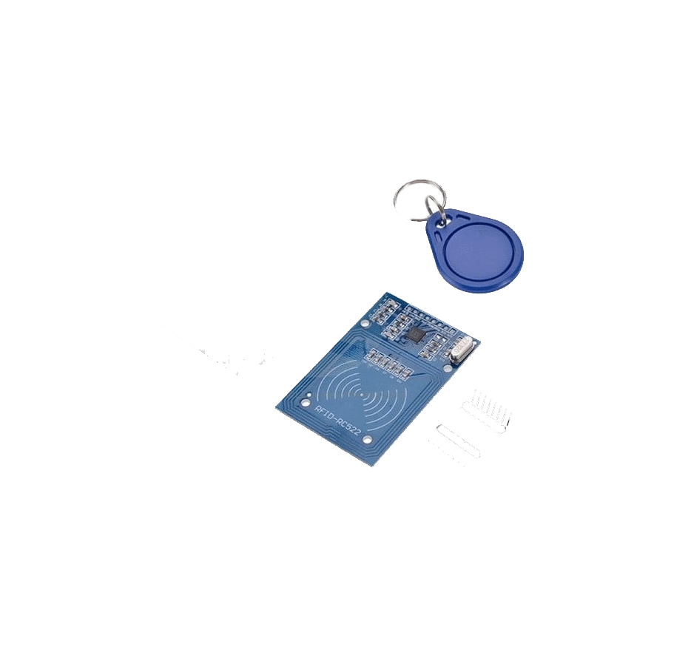
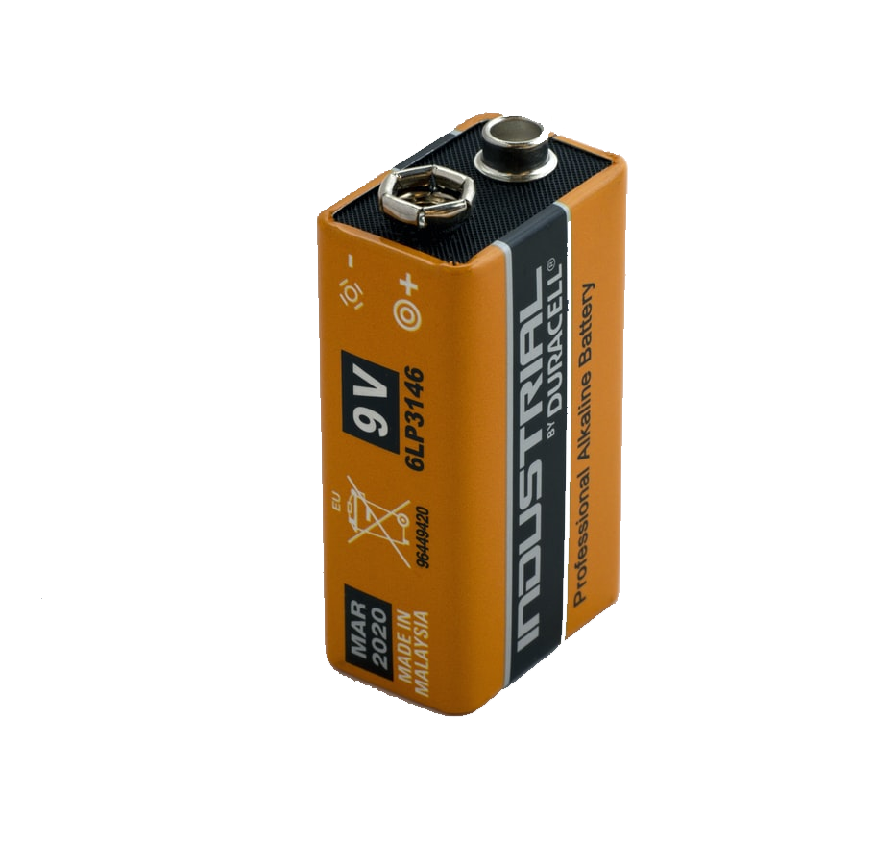
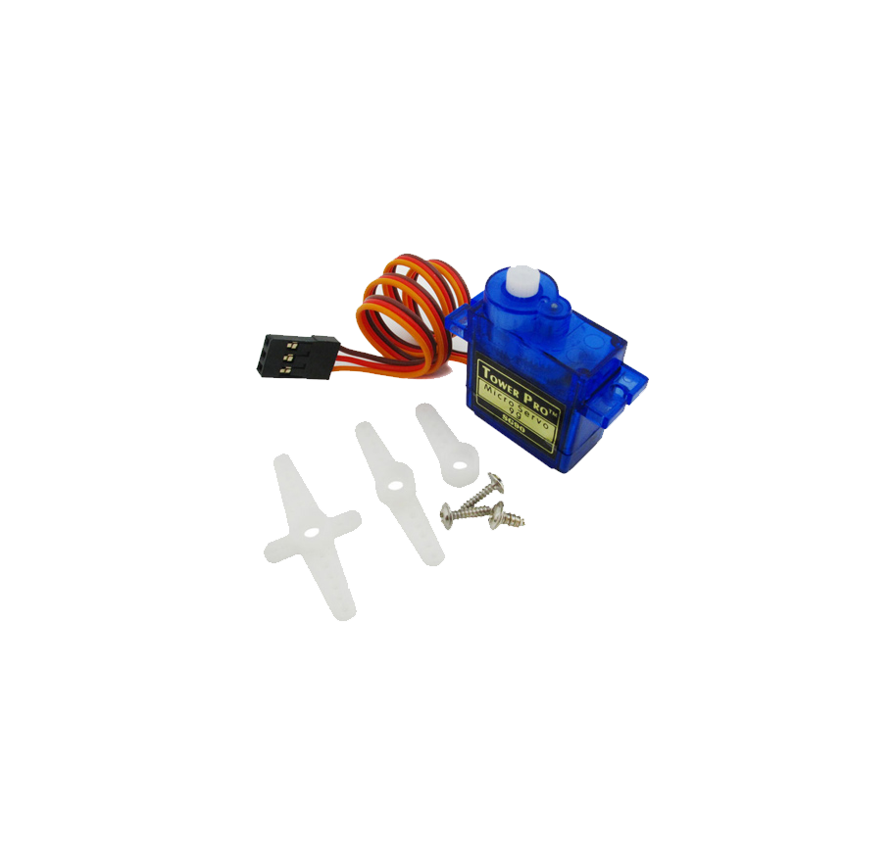
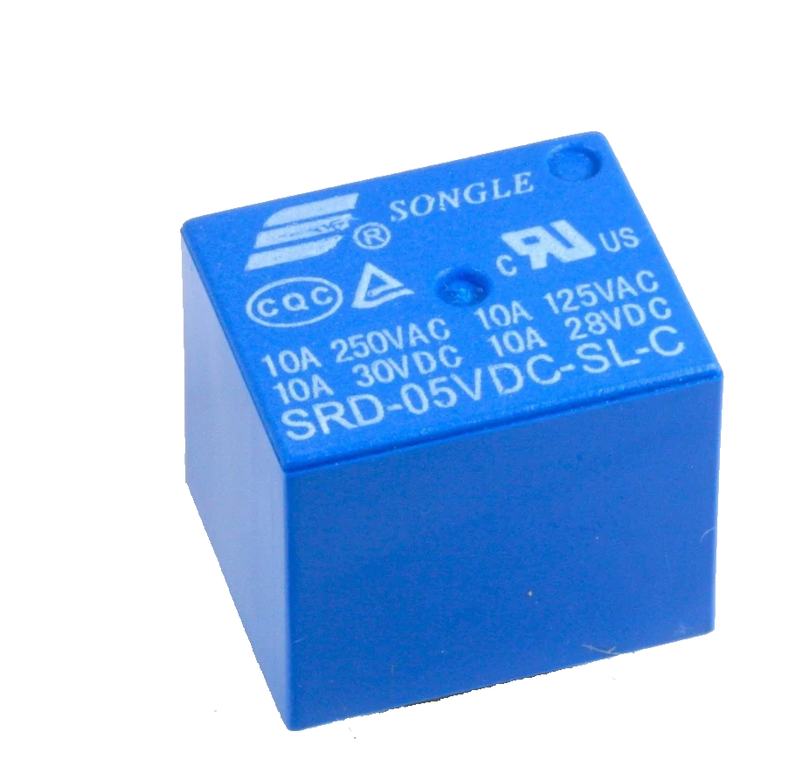
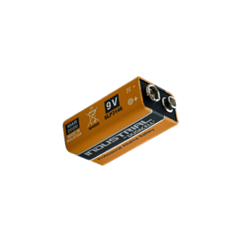
Financials
Complementary Project
Main Project
Component | Price | Real Component
ESP32 Cam | 350
Battery 5V | 50
Main Component | Price | Real Component
ESP 12e | 40
RFID | 70
Servo Motor | 50
Relay | 7
Battery 12V | 30

Slide 20
FUTURE WORK
Mask detection for industrial facilities
Fire detection
Smart object tracking mode
Direct emergency contact
Integrate with bigger smart eco-systems
Two-way audio compatible systems

Slide 21
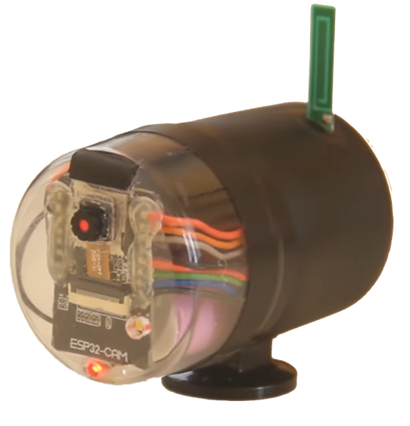
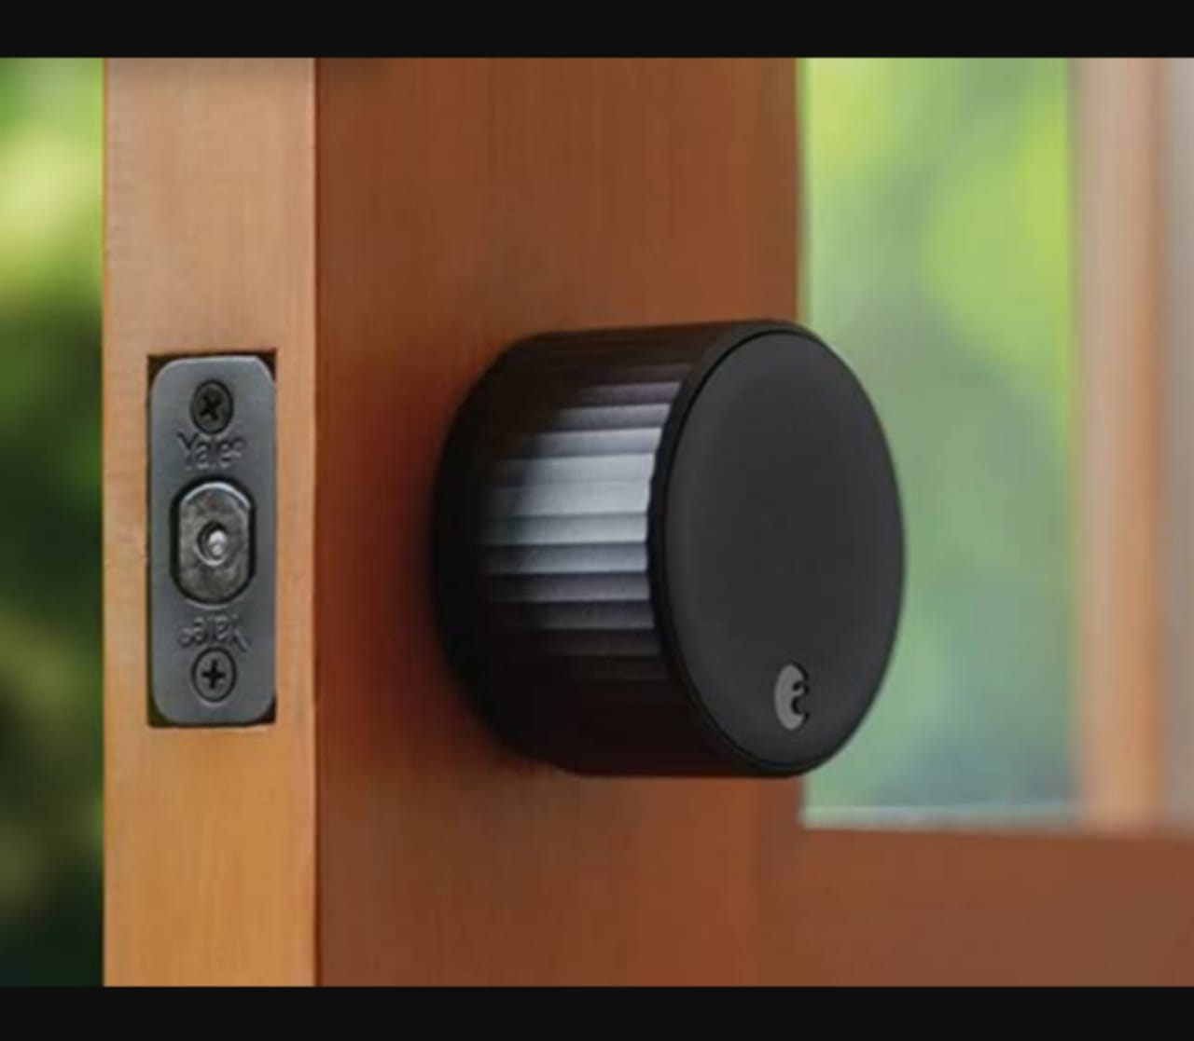
THANKS

